Slide 1
Incremental Network Quantization: Towards Lossless CNNs With Low-Precision Weights
Aojun Zhou, Anbang Yao, Yiwen Guo, Lin Xu, Yurong Chen
Presented by Zhuangwei Zhuang
South China University of Technology
June 6, 2017

Slide 2
Outline
Background
Motivation
Proposed Methods
Variable-length enconding
Incremental quantization strategy
Experimental Results
Conclusions

Slide 3
Background

Slide 4
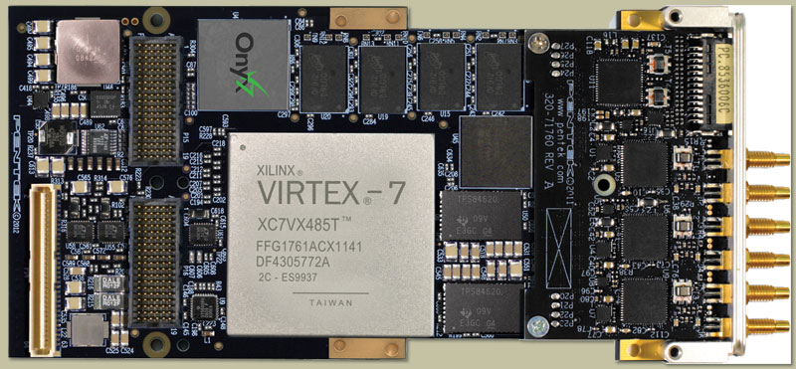
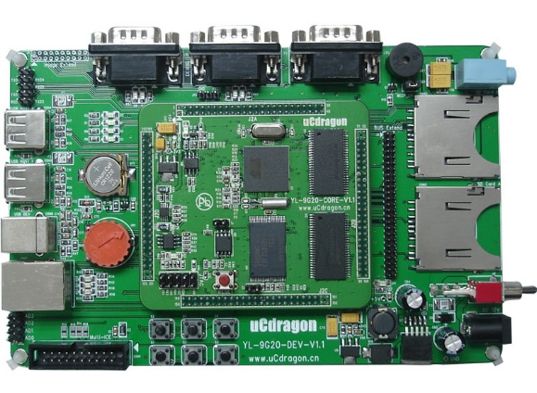
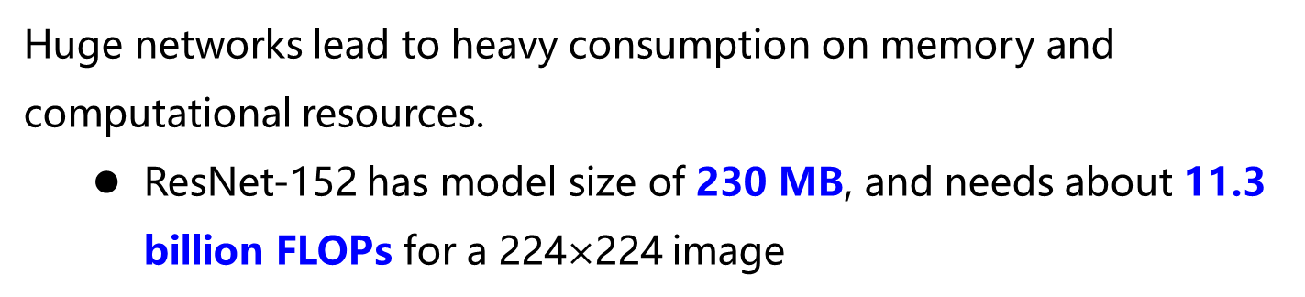
Background
Huge networks lead to heavy consumption on memory and computational resources.
ResNet-152 has model size of 230 MB, and needs about 11.3 billion FLOPs for a 224$×$224 image
Difficult to implement deep CNNs on hardware with the limitation of computation and power.
FPGA
ARM

Slide 5
Motivation

Slide 6

Motivation
Network quantization
low-precision
+1, 0, -1
Floating-point
(full-precision)
Fixed-point
$$2^{n_{1}}, …, 2^{n_{2}}, 0$$
CNN quantization still an open question due to two critical issues:
Non-negligible accuracy loss for CNN quantization methods
Increased number of training iterations for ensuring convergence

Slide 7
Proposed Methods

Slide 8
Proposed Methods
50%
75%
…
100%
Figure. Overview of INQ
Pre-trained model
Weight partition
Group-wise quantization
Retraining
Figure. Quantization strategy of INQ

Slide 9
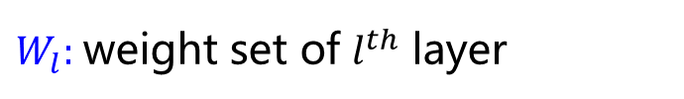
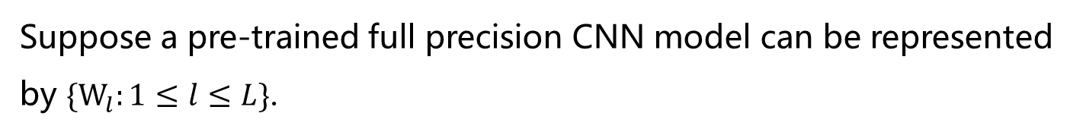
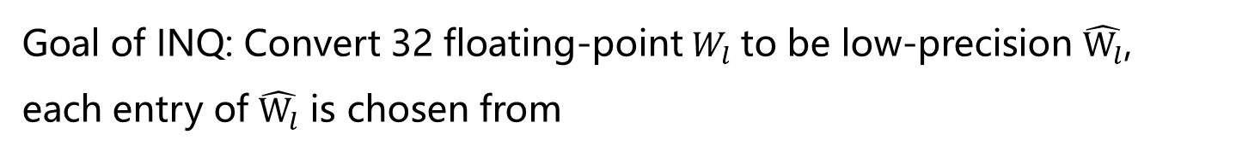
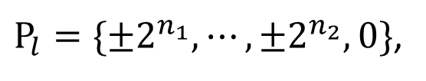

Variable-Length Encoding
Suppose a pre-trained full precision CNN model can be represented by $\{W_{l}:1≤l≤L\}$.
$W_{l}:$weight set of $l^{th}$ layer
$L:$ number of layers
Goal of INQ: Convert 32 floating-point$W_{l}$ to be low-precision $\hat{W_{l}}$, each entry of $\hat{W_{l}}$ is chosen from
$P_{l}=\{±2^{n_{1}}, ⋯, ±2^{n_{2}},0\}$,
where $n_{1}$ and $n_{2}$ are two integer numbers, and $n_{2}≤n_{1}$.

Slide 10

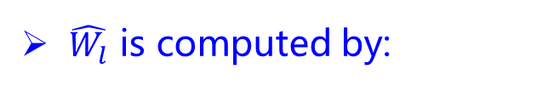
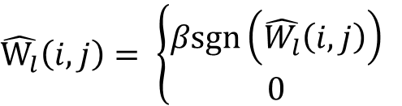

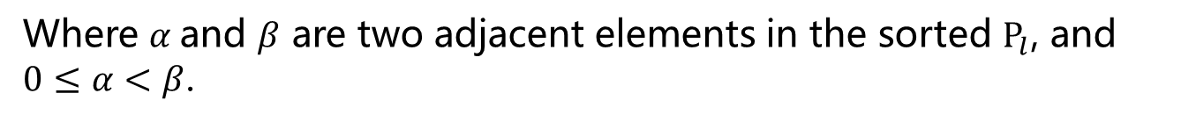

Variable-Length Encoding
$$P_{l}=\{±2^{n_{1}}, ⋯, ±2^{n_{2}},0\}$$
$\hat{W_{l}}$ is computed by:
$$\hat{W_{l}}\left(i, j\right)= \left\{\begin{matrix}βsgn\left(\hat{W_{l}}\left(i, j\right)\right) \\ 0 \end{matrix}\right.$$
$$if \left(α+β\right)≤abs\left(W_{l}\left(i,j\right)\right)<3β/2$$
$$otherwise,$$
Where $α$and $β$ are two adjacent elements in the sorted $P_{l}$, and $0≤α<β$.

Slide 11
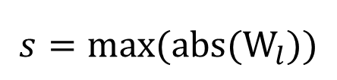

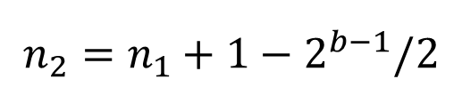
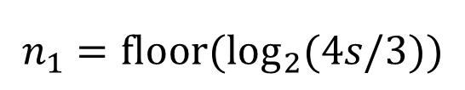
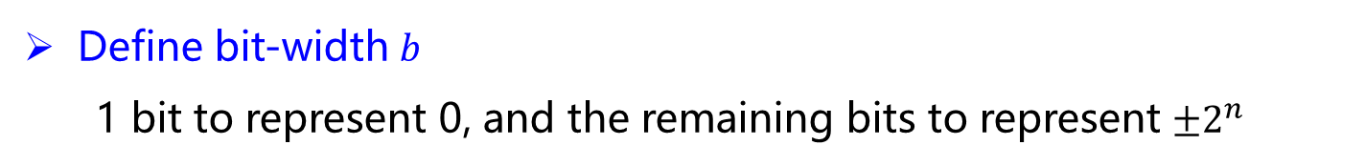
Variable-Length Encoding
$$P_{l}=\{±2^{n_{1}}, ⋯, ±2^{n_{2}},0\}$$
Define bit-width $b$
1 bit to represent 0, and the remaining bits to represent $±2^{n}$
$n_{1}$ and $n_{2}$ are computed by
$$n_{1}=floor(\log_{2}(4s/3))$$
$$n_{2}=n_{1}+1−2^{b−1}/2$$
$s$ is calculated by
$$s=max⁡(abs(W_{l}))$$

Slide 12
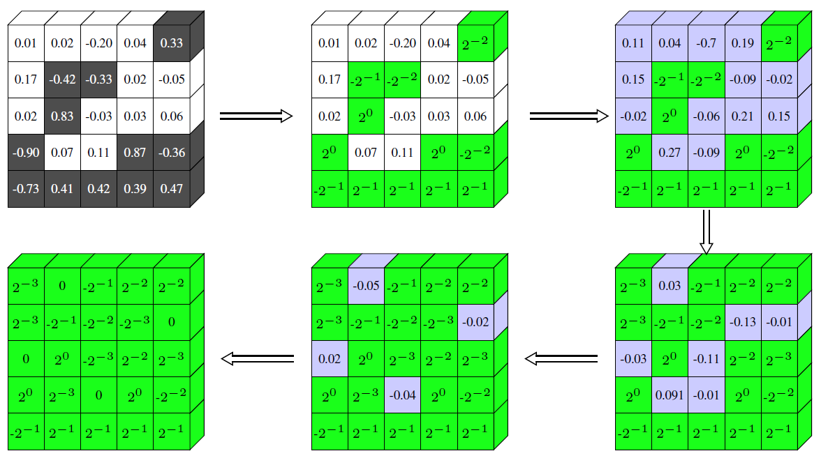
Incremental Quantization Strategy
Figure. Result illustrations
Quantization strategy:
Weight partition: divide weights in each layers into two disjoint groups
Group-wise quantization: quantize weights in first group
Retraining: retrain whole network and update weights in second group

Slide 13
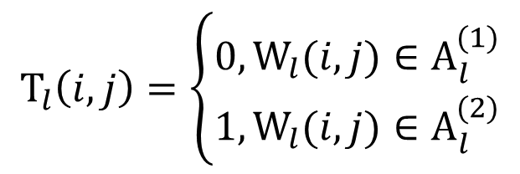
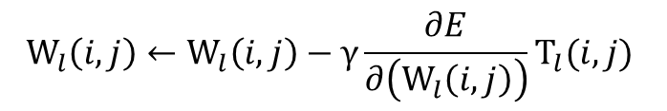
Incremental Quantization Strategy
For the $l^{th}$, weight partition can be defined as
$$A_{l}^{\left(1\right)}∪A_{l}^{\left(2\right)}=\left\{W_{l}\left(i, j\right)\right\}, and A_{l}^{\left(1\right)}∩A_{l}^{\left(2\right)}=∅$$
$A_{l}^{\left(1\right)}$: first weight group that needs to be quantized
$A_{l}^{\left(2\right)}$: second weight group that needs to be retrained
Define binary matrix $T_{l}$
$$T_{l}\left(i, j\right)=\left\{\begin{matrix}0, W_{l}(i,j)∈A_{l}^{(1)} \\ 1, W_{l}(i,j)∈A_{l}^{(2)}\end{matrix}\right.$$
Update $W_{l}$
$$W_{l}\left(i, j\right)←W_{l}\left(i,j\right)−γ\frac{∂E}{∂\left(W_{l}\left(i,j\right)\right)}T_{l}(i,j)$$

Slide 14
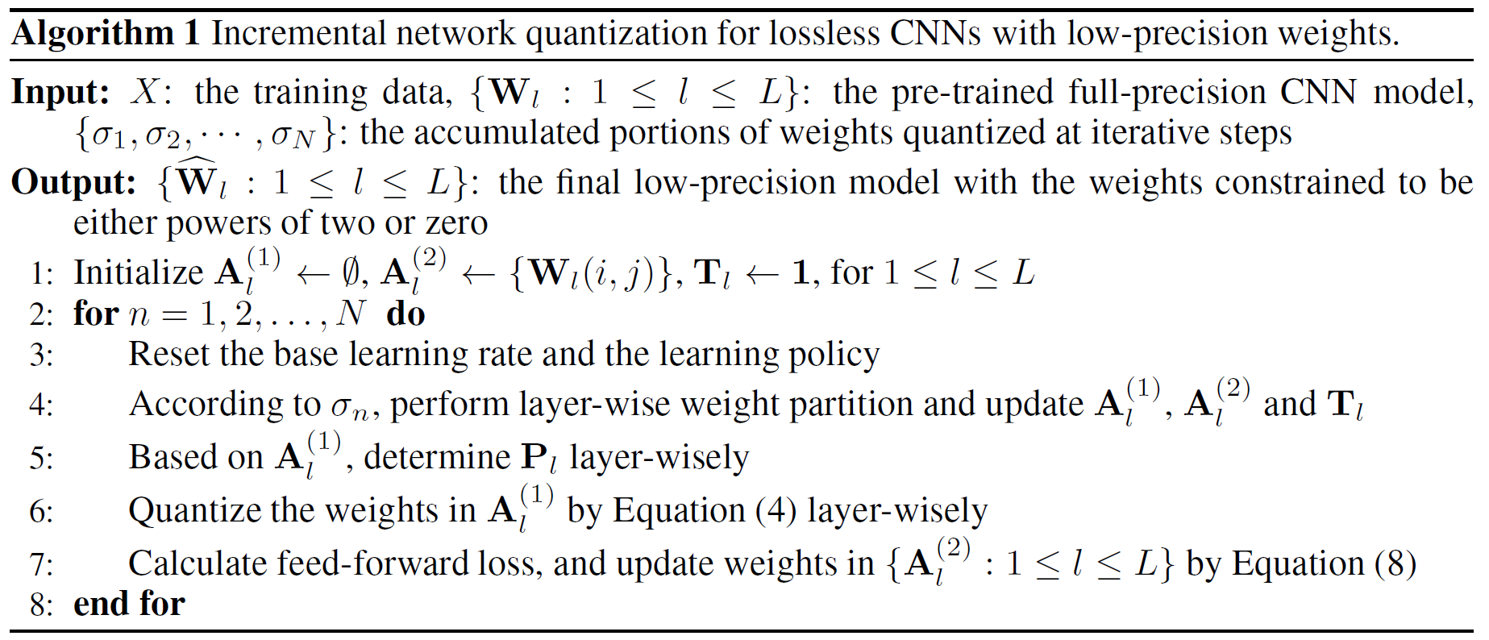
Incremental Quantization Strategy
Algorithm. Pseudo Code of INQ

Slide 15
Experimental Results

Slide 16
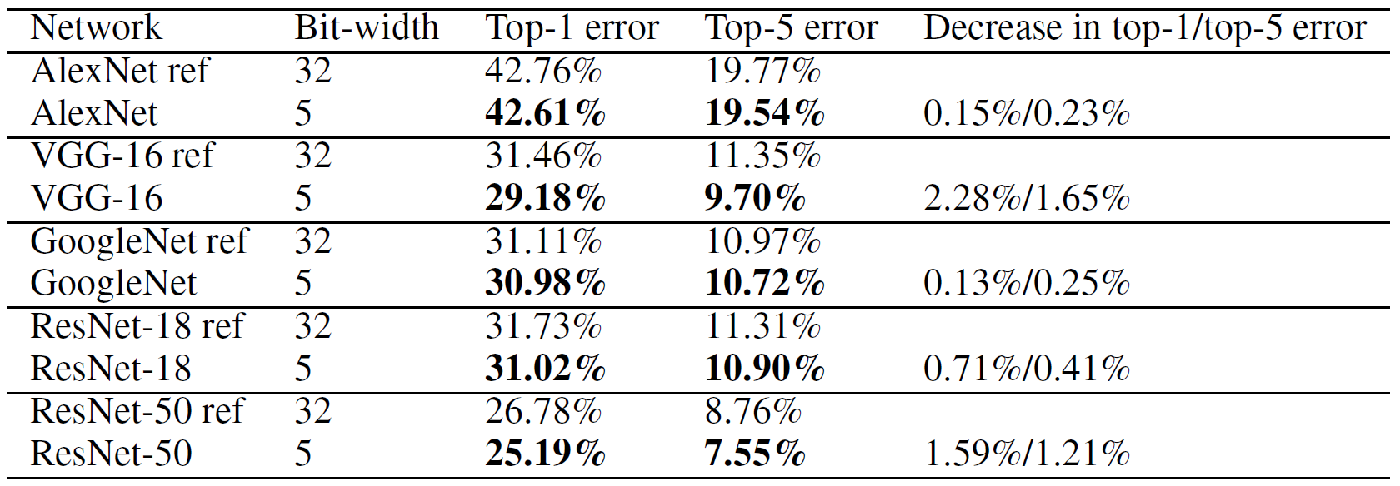
Results on ImageNet
Table. Converting full-precision models to 5-bit versions

Slide 17
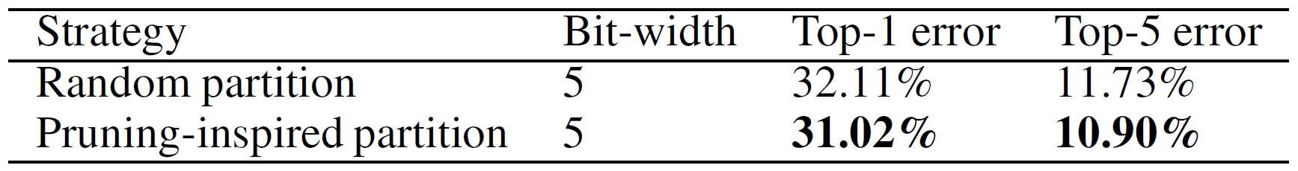
Analysis of Weight Partition Strategies
Random partition: all weights have equal probability to fall into the two groups
Pruning-inspired partition: weights with larger absolute values have more probability to be quantized
Table. Comparison of different weight partition strategies on ResNet-18

Slide 18
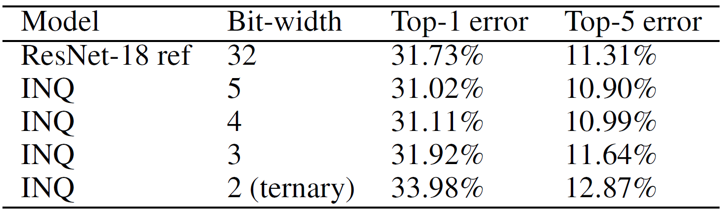
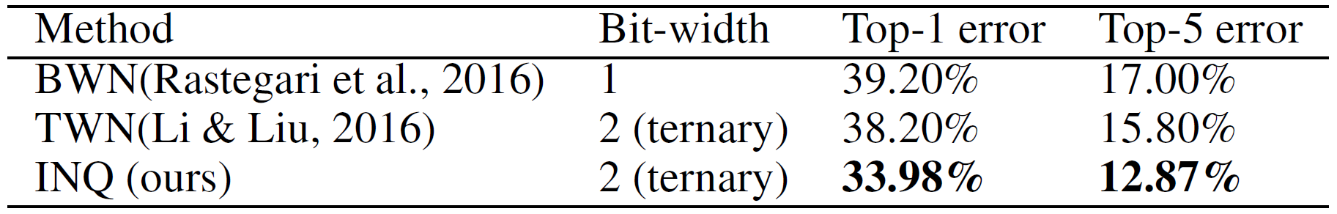
Trade-Off Between Bit-Width and Accuracy
Table. Exploration on bit-width on ResNet-18
Table. Comparison of the proposed ternary model and the baselines on ResNet-18

Slide 19
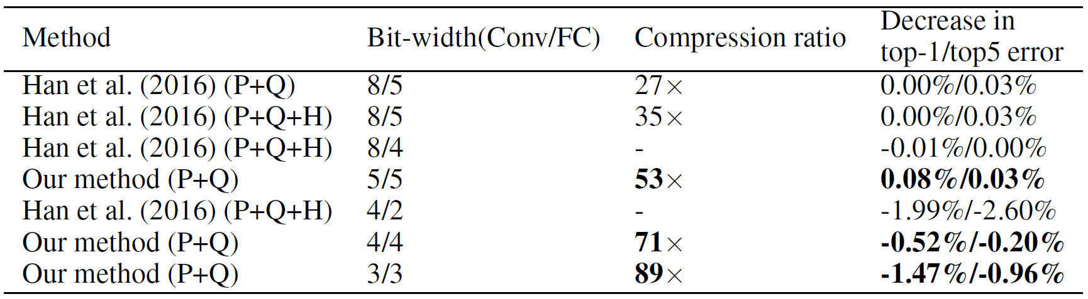
Low-Bit Deep Compression
Table. Comparison of INQ+DNS, and deep compression method on AlexNet. Conv: Convolutional layer, FC: Fully connected layer,
P: Pruning, Q: Quantization, H: Huffman coding

Slide 20
Conclusions

Slide 21
Conclusions
Contributions
Present INQ to convert any pre-trained full-precision CNN model into a lossless low-precision version
The quantized models with 5/4/3/2 bits achieve comparable accuracy against their full-precision baselines
Future work
Extend incremental idea from low-precision weights to low-precision activations and low-precision gradients.
Implement the proposed low-precision models on hardware platforms

Slide 22
Q & A

Slide 23
References
[1] Aojun Zhou, Anbang Yao, Yiwen Guo, Lin Xu, and Yurong Chen. Incremental network quantization: Towards lossless cnns with low-precision weights. In ICLR, 2017.
[2] Yiwen Guo, Anbang Yao, and Yurong Chen. Dynamic network surgery for efficient dnns. In NIPS, 2016.
[3] Song Han, Jeff Pool, John Tran, and William J. Dally. Learning both weights and connections for efficient neural networks. In NIPS, 2015.
[4] Song Han, Jeff Pool, John Tran, and William J. Dally. Deep compression: Compressing deep neural networks with pruning, trained quantization and Huffman coding. In ICLR, 2016.
[5] Fengfu Li and Bin Liu. Ternary weight networks. arXiv preprint arXiv: 1605.04711v1, 2016
[6] Mohammad Rastegari, Vicente Ordonez, Joseph Redmon, and Ali Farhadi. Xnor-net: Imagenet classification using binary convolutional neural networks. arXiv preprint arXiv: 1603.05279v4, 2016.

